Slide 1

Zomato Restaurants Expansion
Guruprasad kandgal

Slide 2

About Zomato
Zomato is an Indian multinational restaurant aggregator and food delivery company.
Zomato provides information, menus and user-reviews of restaurants as well as food delivery options from partner restaurants in more than 1,000 Indian cities and towns.

Slide 3

Problem statement
The primary objective is to identify cities and countries where new restaurant openings can maximize market penetration, profitability, and brand recognition while mitigating risks associated with new market entry.

Slide 4
Data Description
Has_Table_booking: Indicates whether the restaurant has a table booking option (Yes/No).
Has_Online_delivery: Indicates whether the restaurant offers online delivery (Yes/No).
Is_delivering_now: Indicates whether the restaurant is currently delivering (Yes/No).
Switch_to_order_menu: Indicates whether users can switch to the order menu (Yes/No).
Price_range: A numeric value indicating the price range category of the restaurant.
Votes: The number of votes or ratings/(feedback) received by the restaurant.
Average_Cost_for_two: The average cost for two people dining at the restaurant.
Rating: The overall rating of the restaurant is based on user reviews.
Datekey_opening: The date when the restaurant was opened.
Restaurant ID: Unique identifier for each restaurant.
Restaurant Name: The name of the restaurant.
CountryCode: Country code of the location where the restaurant is situated.
City: The city where the restaurant is located.
Address: The specific address of the restaurant.
Locality: The locality or neighborhood where the restaurant is situated.
Locality Verbose: Detailed information about the locality.
Longitude: The geographical longitude coordinate of the restaurant.
Latitude: The geographical latitude coordinate of the restaurant.
Cuisines: The type of cuisine offered by the restaurant.
Currency: The currency used for transactions in the restaurant.

Slide 5

Key Insights

Slide 6
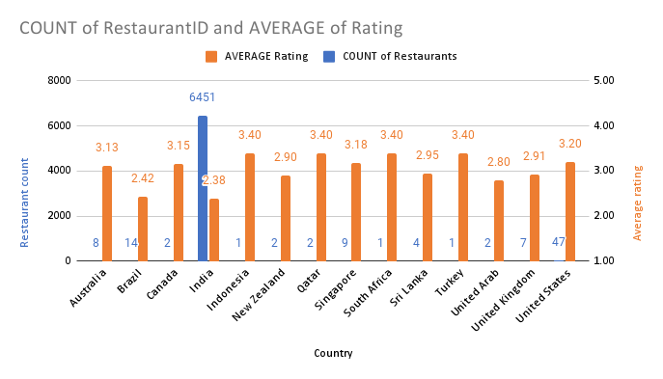
Identify Countries with Low Competition
Analysis:
Canada, Singapore, and Australia have been identified as potential locations with lower competition based on the number of restaurants and their ratings.
These countries present opportunities for strategic expansion of the restaurant chain.
Recommendation:
Consider entering these markets where competition is less intense, allowing for better market penetration and establishment of brand presence.

Slide 7
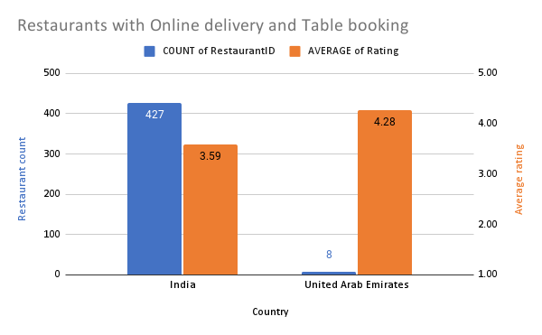
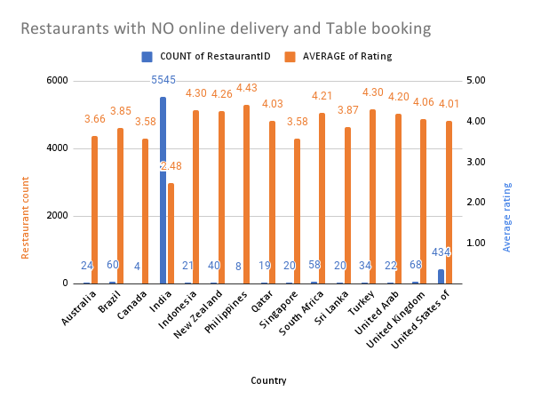
Leverage Service Availability
Analysis:
Implementing online delivery and table booking services in Singapore and Australia could improve customer convenience and potentially enhance restaurant ratings, particularly in regions with moderate to low ratings.
Recommendation:
Integrate online delivery and table booking services in these regions to attract more customers and improve overall customer satisfaction.

Slide 8
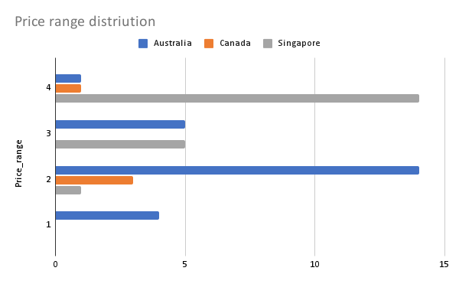
Expenditure Consideration
Analysis:
Singapore's higher dining costs stand in contrast to the more affordable options in Australia and Canada, highlighting the need for different pricing strategies.
Recommendation:
When opening new restaurants, align pricing and cost management with the local economic environment to optimize profitability while meeting customer expectations.

Slide 9
Services
Analysis:
Singapore has an average rating of 3.58 without online delivery and table booking, suggesting potential for improvement. Offering these services could attract more customers and enhance ratings.
Australia, with a rating of 3.66, shows a similar need for improvement. In contrast, Canada’s rating of 3.85 indicates a relatively positive perception even without these services, making the introduction of online delivery and table booking less critical.
Recommendation:
Focus on integrating online delivery and table booking services in Singapore and Australia to boost customer convenience and potentially increase ratings. For Canada, consider these services as an enhancement rather than a necessity.

Slide 10
Strategic Recommendation
Focus on Less Competitive Markets: Target countries with fewer existing restaurants, like Canada, Singapore, and Australia, to reduce competition and capture market share.
Enhance Online Delivery Services: Expand and promote online food delivery in regions with many restaurants but limited delivery options, boosting restaurant sales and customer convenience.
Tailor Pricing Strategies: Adjust restaurant pricing based on the local economic conditions and customer behavior to balance profitability with affordability.
Localize Marketing Efforts: Customize marketing campaigns to resonate with local cultures, using regional flavors, languages, and partnerships to build strong customer connections.

Slide 11
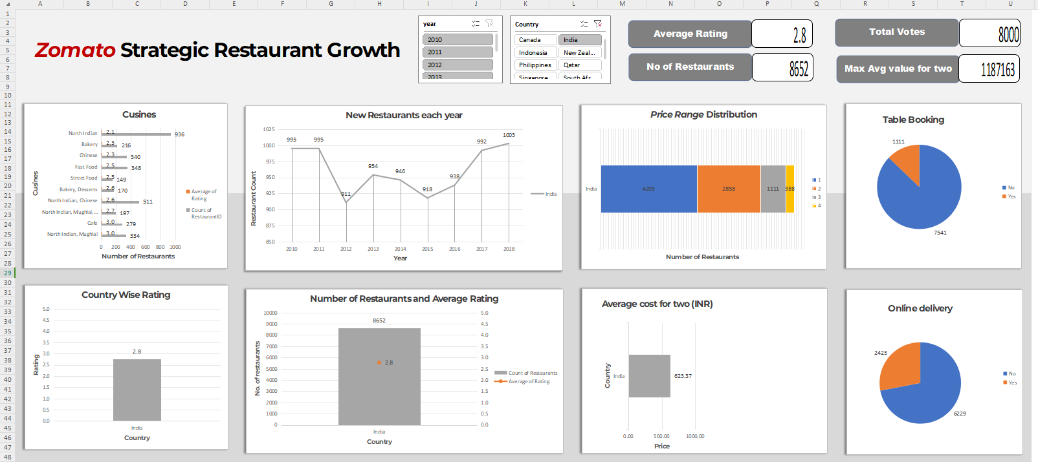
Dashboard

Slide 12
Conclusion
Strategic Market Selection: Focus on countries with low competition and high customer satisfaction for successful expansion.
Leverage Technology: Expand online delivery and use data-driven decisions to stay competitive.
Tailored Approaches: Customize pricing and marketing to local economic and cultural conditions.
Continuous Improvement: Adapt based on feedback and market conditions for long-term growth.
Long-Term Vision: Build a sustainable expansion plan focusing on customer satisfaction and market differentiation.

Slide 13
Thank You

